Slide 1
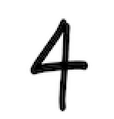
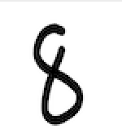

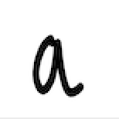
Handwriting Recognition
------Victor, Kaan, Bill

Slide 2
Why important?
Lots of Application: Reading postal addresses, bank check amounts, and forms
OCR-Allowing the entry of image textual information into computers by digitization, image restoration, and recognition methods.

Slide 3
Procedures
Data preprocessing
Construct machine learning algorithms
Validation/test to find the best settings i.e. hyperparameters, batch size, etc.
Compare and find the best architecture
Train/test
Preprocess input (prediction) data
Predict

Slide 4
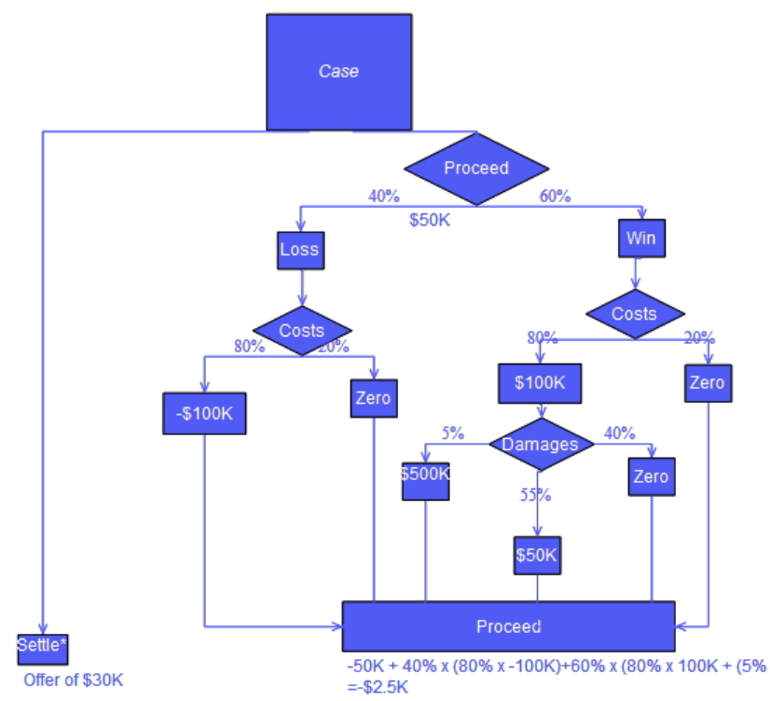
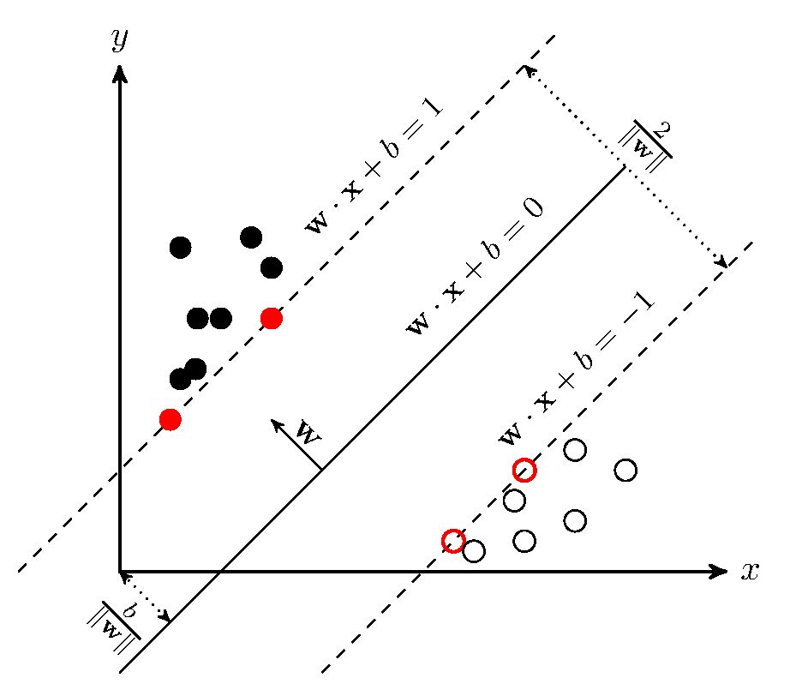

Machine Learning Models Used
Decision Tree
SVM
Neural Network

Slide 5

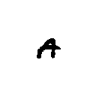
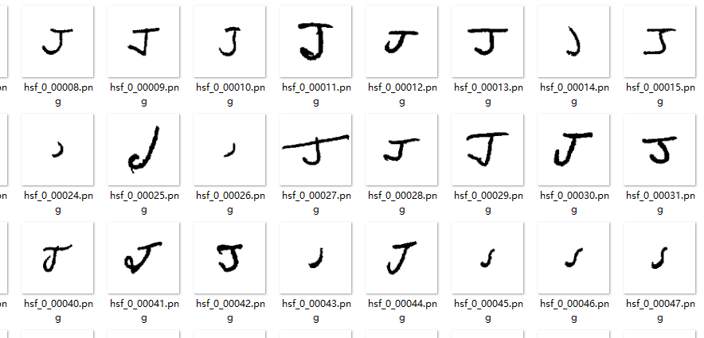
Data Preprocessing
The Dataset we’ve used: NIST Special Database 19[1] (“by_merge” category)
Over 800,000 images of digits and characters
128x128 image of single digits and characters
Need to downsample the image while keeping as much of the features as possible
Uses Opencv for preprocessing
Binarization
Custom cropping
Noise removal
Thinning
Skeletonization
[1] https://www.nist.gov/srd/nist-special-database-19

Slide 6
Data Preprocessing
Binarization is simple.
Read the image in grayscale. Every pixel is represented as a np.uint8 number from 0 to 255.
Any pixel below the threshold (177) is set to 0 (black), and anything above 255 (white).
img = np.array(img) if not isinstance(img,type(np.array([]))) else img
img = cv.cvtColor(img, cv.COLOR_BGR2GRAY)
new_image = binarization(img, threshold)
def binarization(img, threshold): # reduce channel to 1 and binarize each grey scaled pixel.
ret, thresh = cv.threshold(img, threshold, 255, cv.THRESH_BINARY)
return thresh

Slide 7
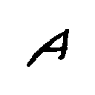
Data Preprocessing
128x128 -----> 28x28
Center of Mass Cropping
Compute the weighted center of mass
Find the smallest square that covers the mass of the image
Adjust the square such that it is centered at the center of mass
If the new square exceeds the boundary, do some padding
Crop the image with the square and resize it to 20x20
Pad the processed image so that it becomes 28x28
128x128
128x128
Smallest square
Cropping square
Center of mass
Center of mass
padding
28x28
20x20

Slide 8
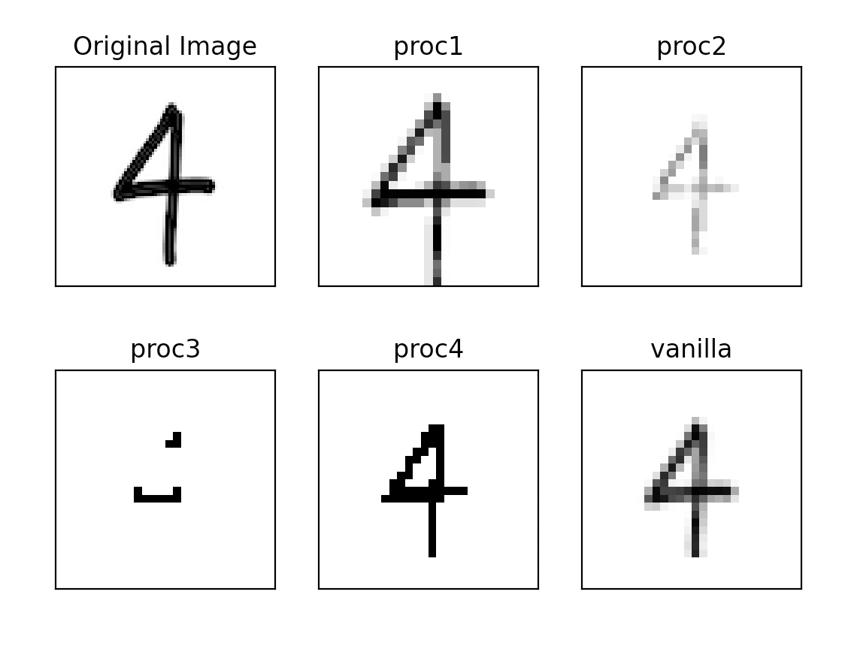
Data Preprocessing
Comparing some processing procedures
preprocess_procedure_1 # binarization -> noise remove -> thinning -> cropping
procedure_2 # binarization -> noise remove -> skeletonization -> cropping
procedure_3 # cropping -> binarization -> noise remove -> thinning
procedure_4 # cropping -> binarization -> noise remove -> skeletonization
Vanilla # binarization -> cropping
Some of the procedures over-present the data. Vanilla works just fine, could need some thinning.

Slide 9
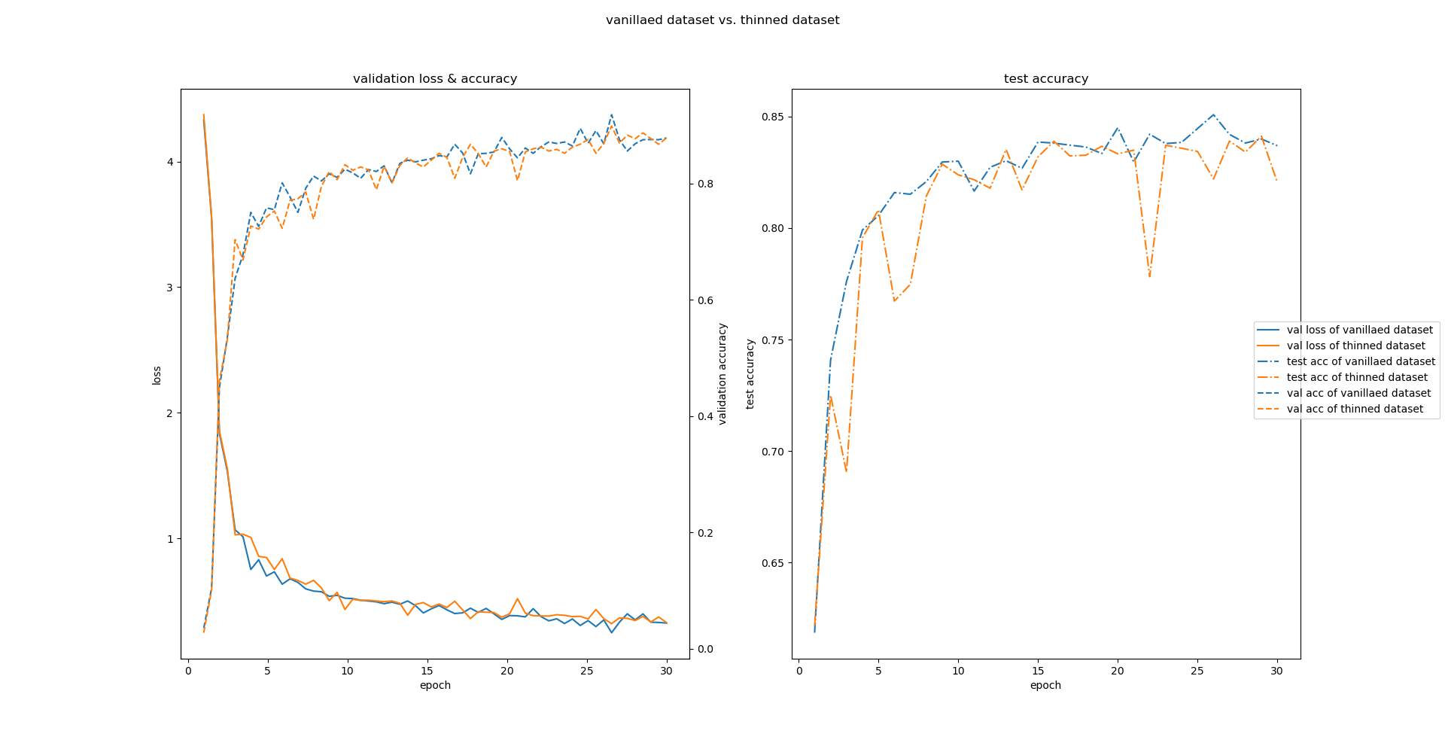
Using CNN introduced later, we found that the vanilla way of preprocessing works the best

Slide 10
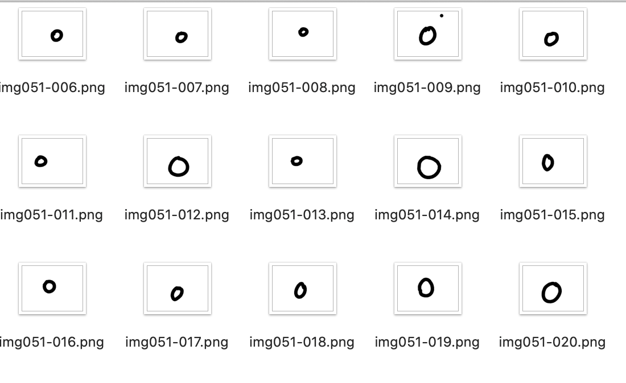
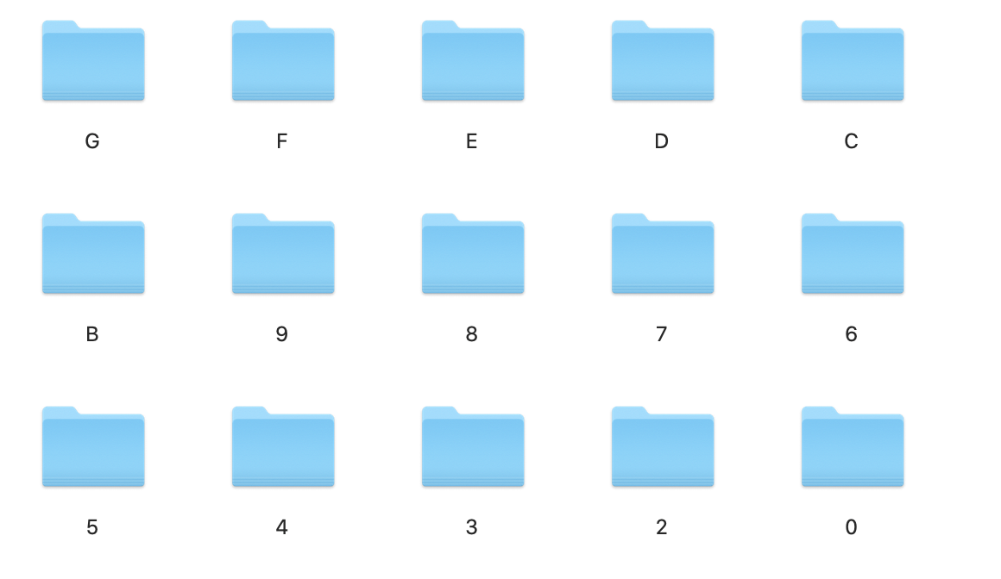

Decision Tree on Recognition

Slide 11
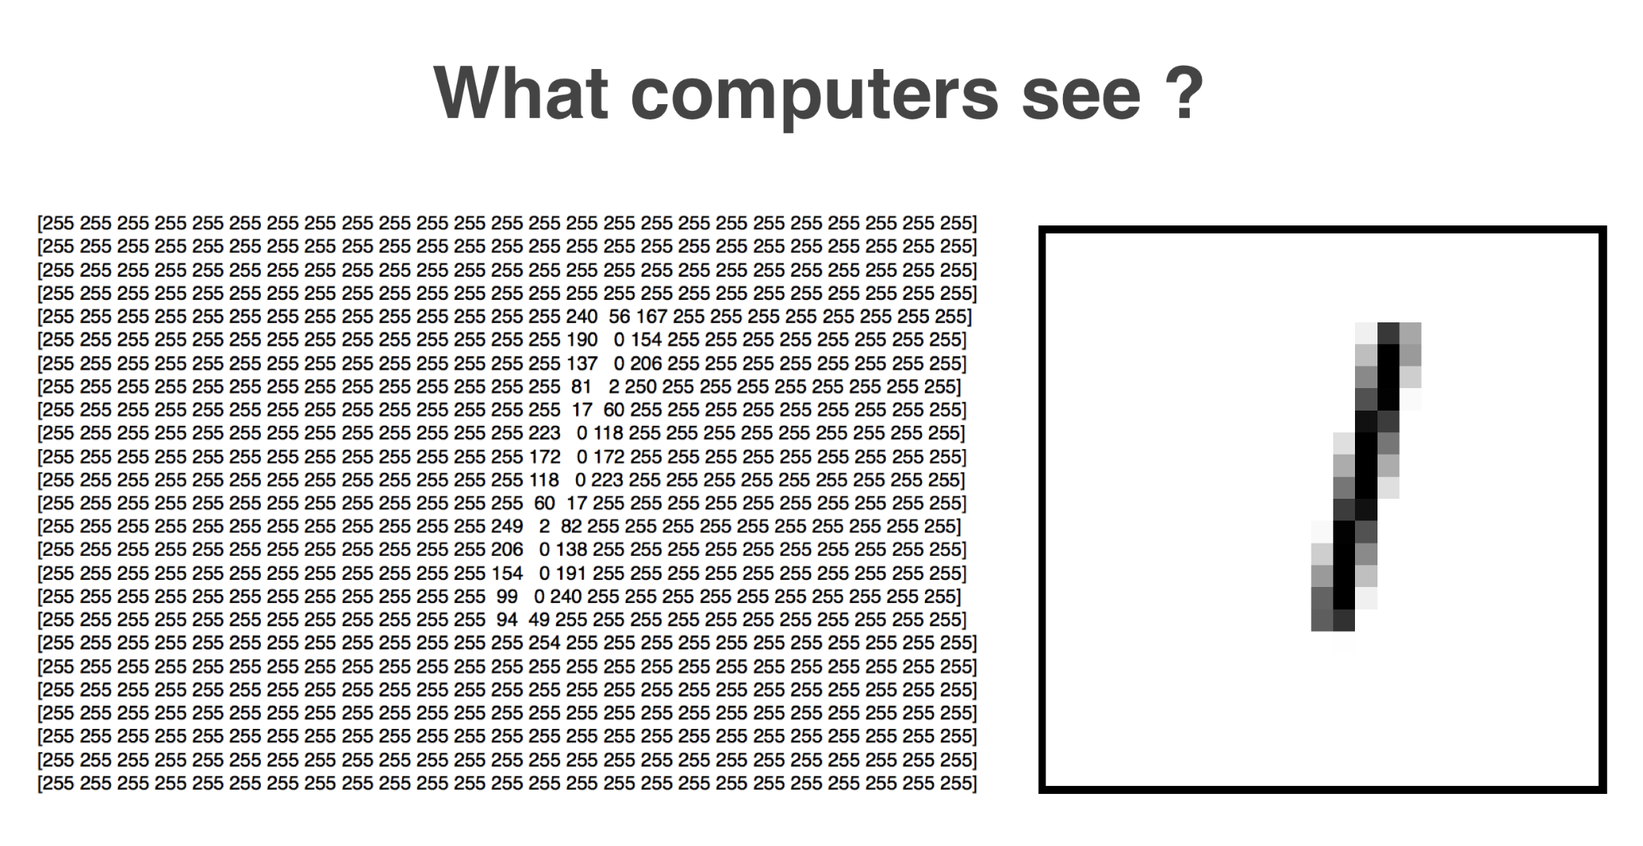

Slide 12
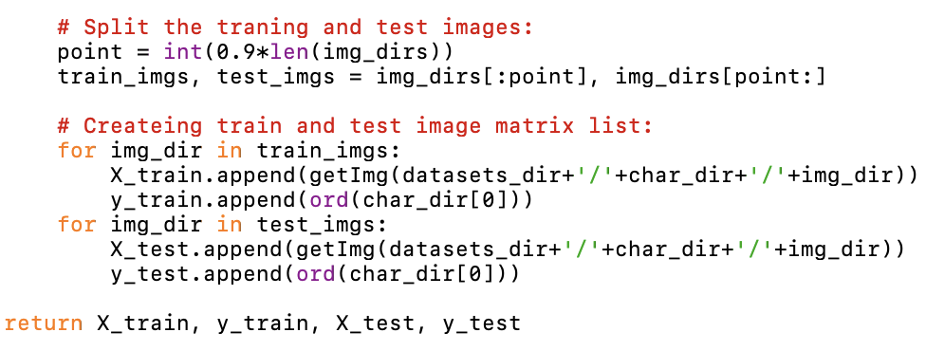
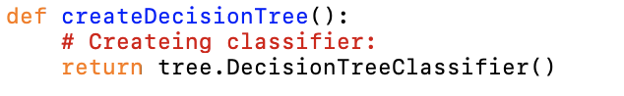

Slide 13
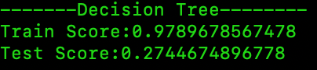
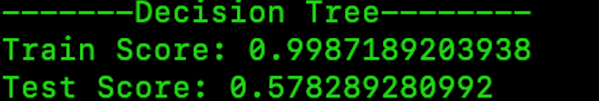
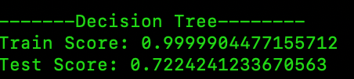
Data Progression
Merged & Processed (Vanillaed)
Raw unmerged
Merged but not processed

Slide 14
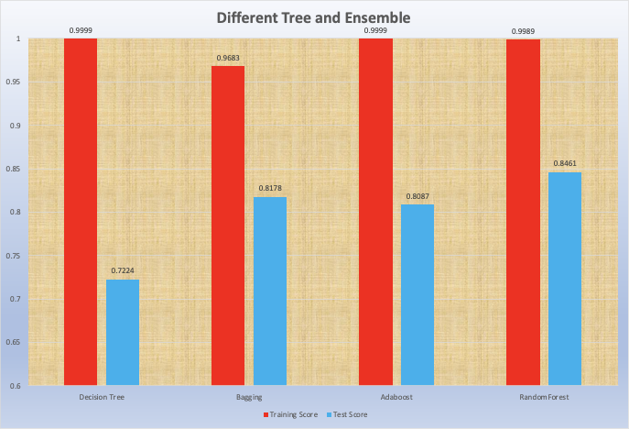
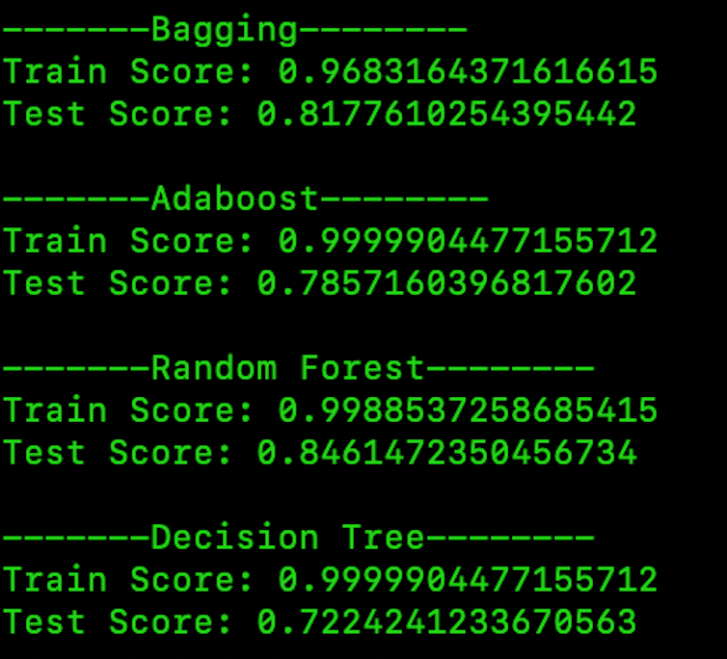
Trees & Ensembles
Decision Tree
Bagging
Adaboost
Random Forest

Slide 15
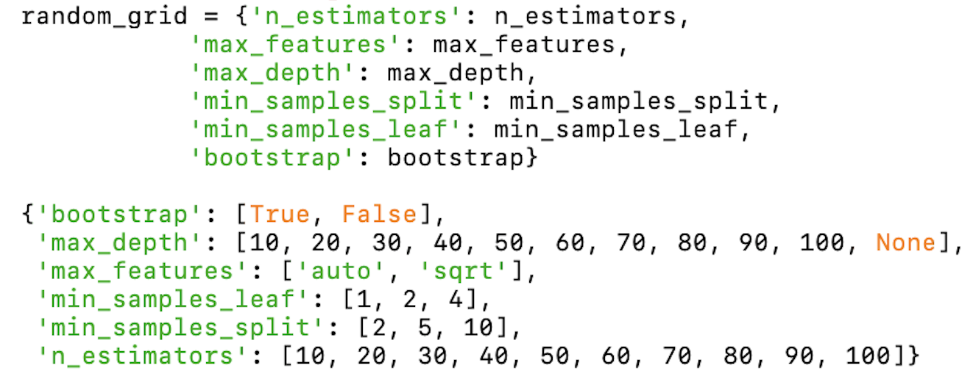
Hyperparameter Tuning
100 combinations
3 fold
Random Hyperparameter Grid

Slide 16
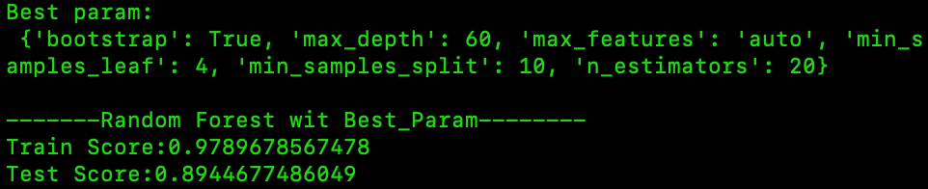

Slide 17
Support Vector Machine

Slide 18
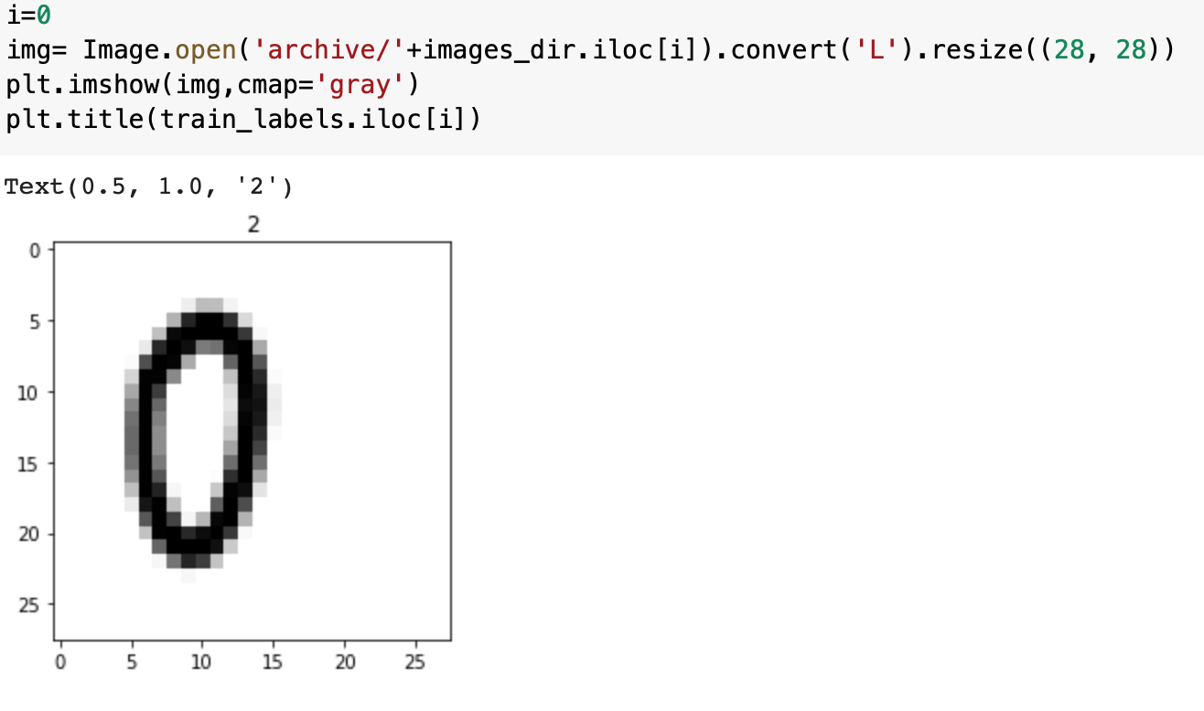
The images we use here

Slide 19
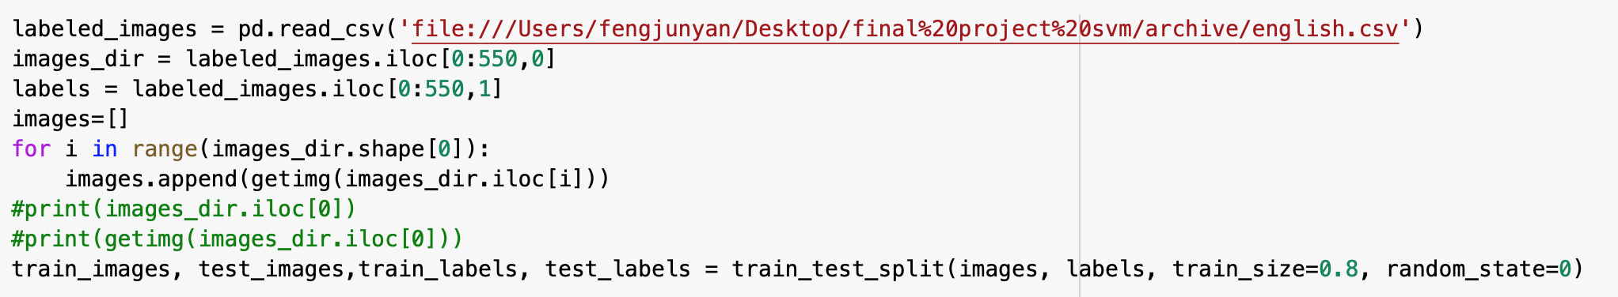
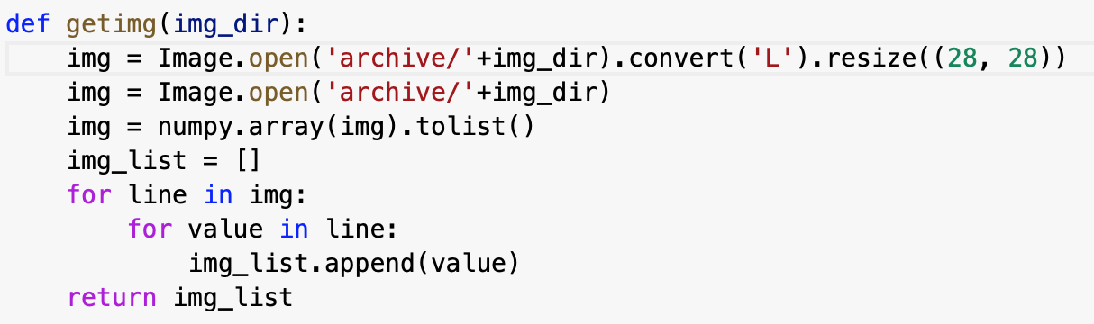
train-test-split

Slide 20
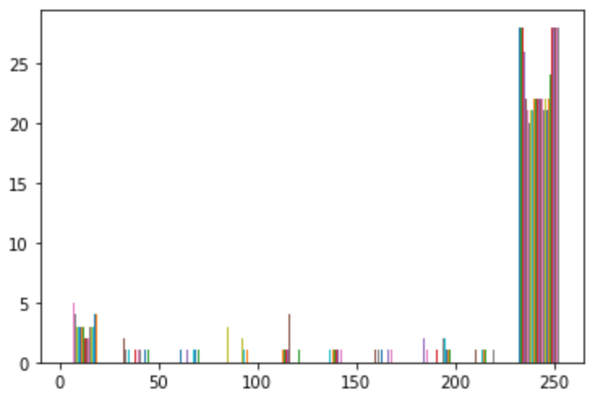
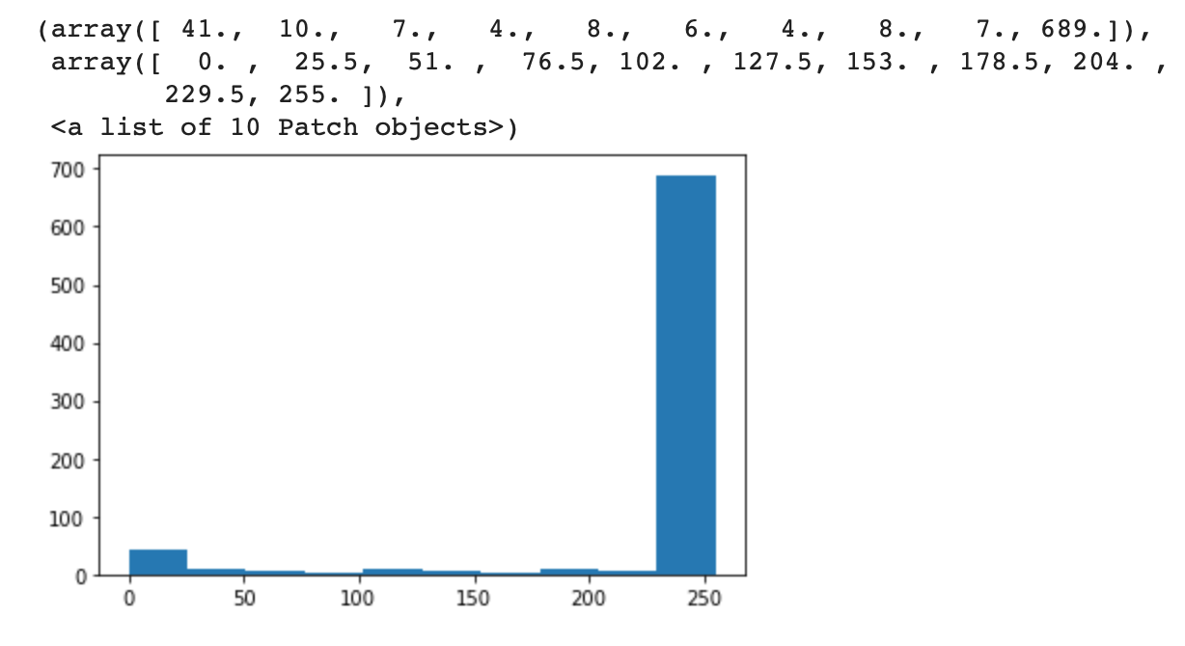
The distribution of pixel/gray-scale values

Slide 21
Tuning the hyperparameters

Slide 22
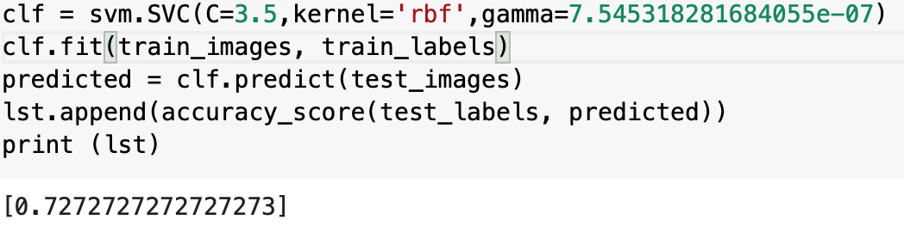
Do the prediction

Slide 23
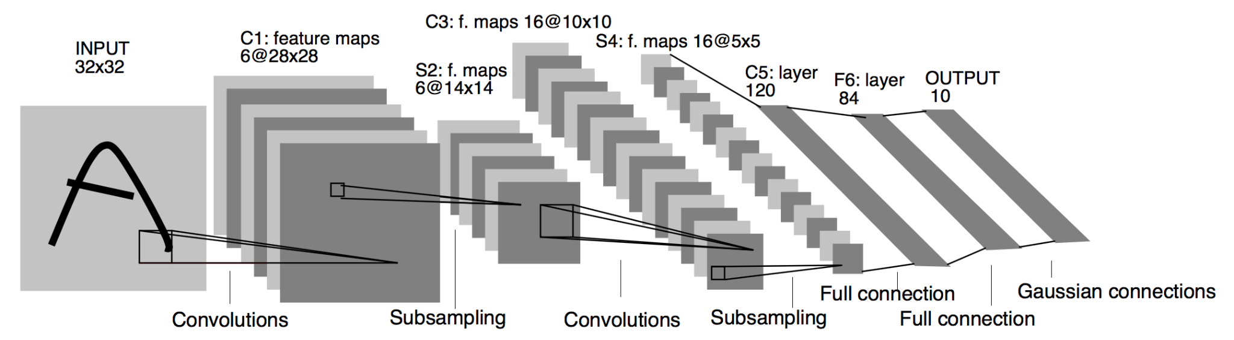
CNN & CNN Feature extraction + SVM
Old-schooled machine learning algorithms seem to work alright, but not enough
Implementing CNN modified from classic CNN architecture (LeNet-5) for direct classification or feature extraction
For the features extraction approach, the features are then fed into a SVM model
Relatively simple, and fast!
LeNet-5 architecture as published in the original paper.

Slide 24
CNN Only
47x1 vector
47x1 vector
47x1 vector
Three structures:
FC 84, 47
FC 84, 47
FC 84, 47
ReLU
Sigmoid
ReLU
FC 120, 84
FC 120, 84
FC 120, 84
ReLU
Sigmoid
ReLU
FC 240, 120
ReLU
FC 400, 120
FC 400, 120
FC 128, 240
Flatten
Flatten
Flatten
AvgPool 2x2 stride 2
MaxPool 2x2 stride 2
MaxPool 2x2 stride 2
BatchNorm & ReLU
Sigmoid
BatchNorm & ReLU
16 Conv 3x3
16 Conv 5x5
16 Conv 5x5
MaxPool 2x2 stride 2
BatchNorm & ReLU
AvgPool 2x2 stride 2
MaxPool 2x2 stride 2
16 Conv 3x3
Sigmoid
BatchNorm & ReLU
MaxPool 2x2 stride 2
6 Conv 5x5
8 Conv 5x5
BatchNorm & ReLU
8 Conv 3x3
28x28 image
28x28 image
28x28 image
Architecture with 2 Conv layers and 3 FC layers
Improved Architecture with 3 Conv layers and 4 FC layers
Classic LeNet-5 architecture

Slide 25
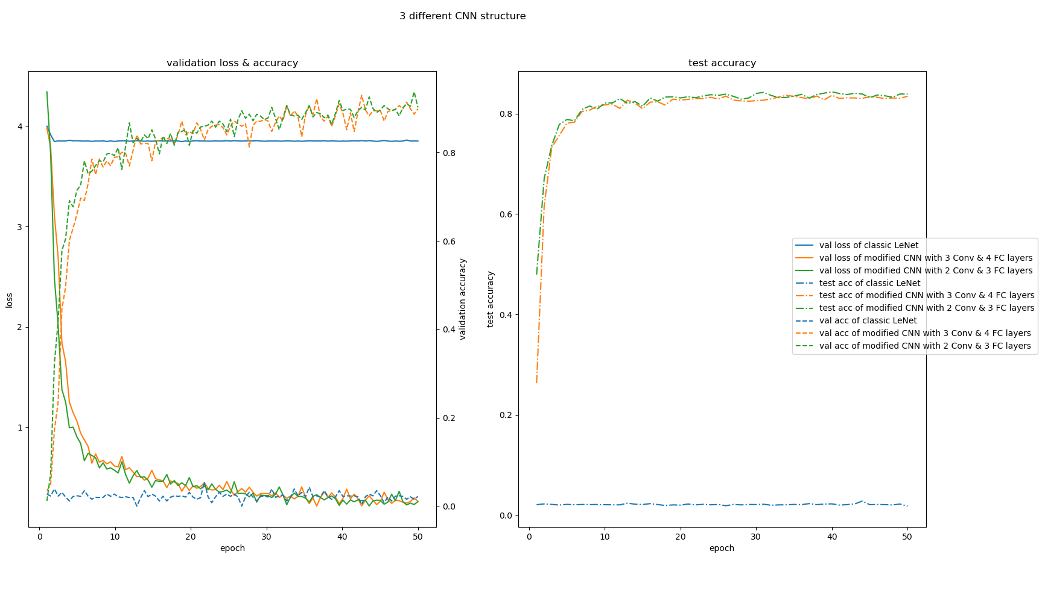

Slide 26
Validation
Many settings & hyperparameters to tune:
Dataset size
Batch size
Number of epochs
Optimizer & learning rate & weight decay & momentum, etc.
Dropout rate
Train, validation, test dataset ratio: 3:1:1

Slide 27
Dataset size tuning
The problem of imbalanced data
The smallest class contains only around 5,000 images
No need for extremely large data amount
Solution:
Weighted random sampler
Scale the dataset by up to 0.25

Slide 28
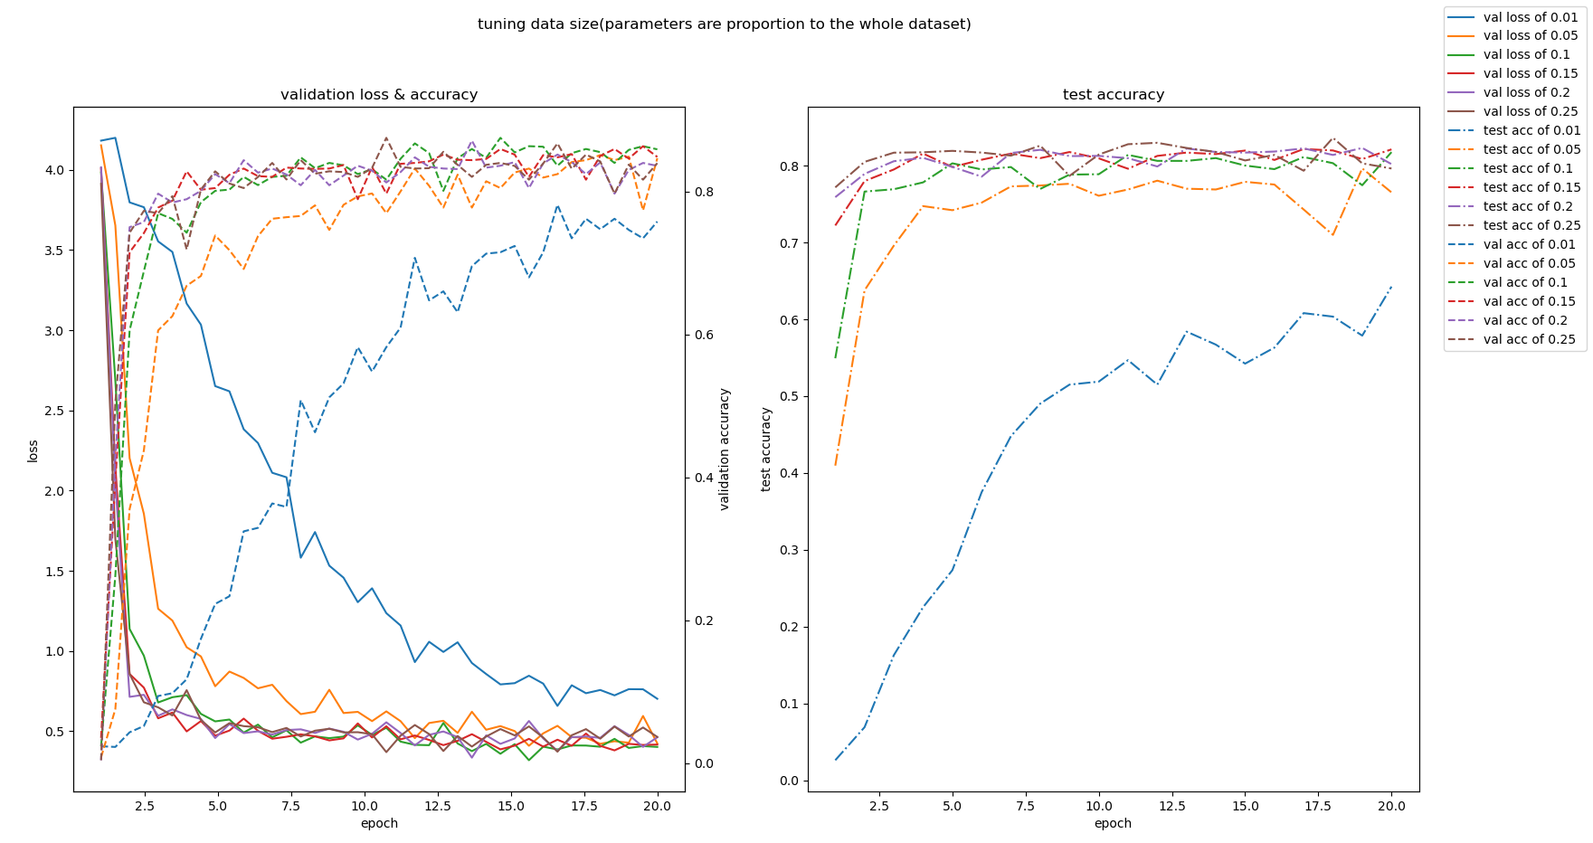

Slide 29
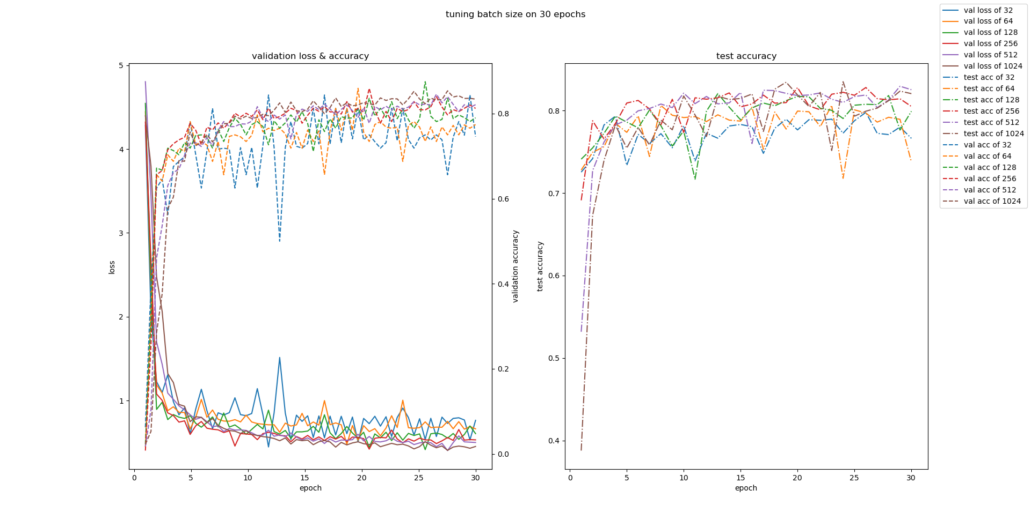
Batch size tuning
The bigger, the better?

Slide 30
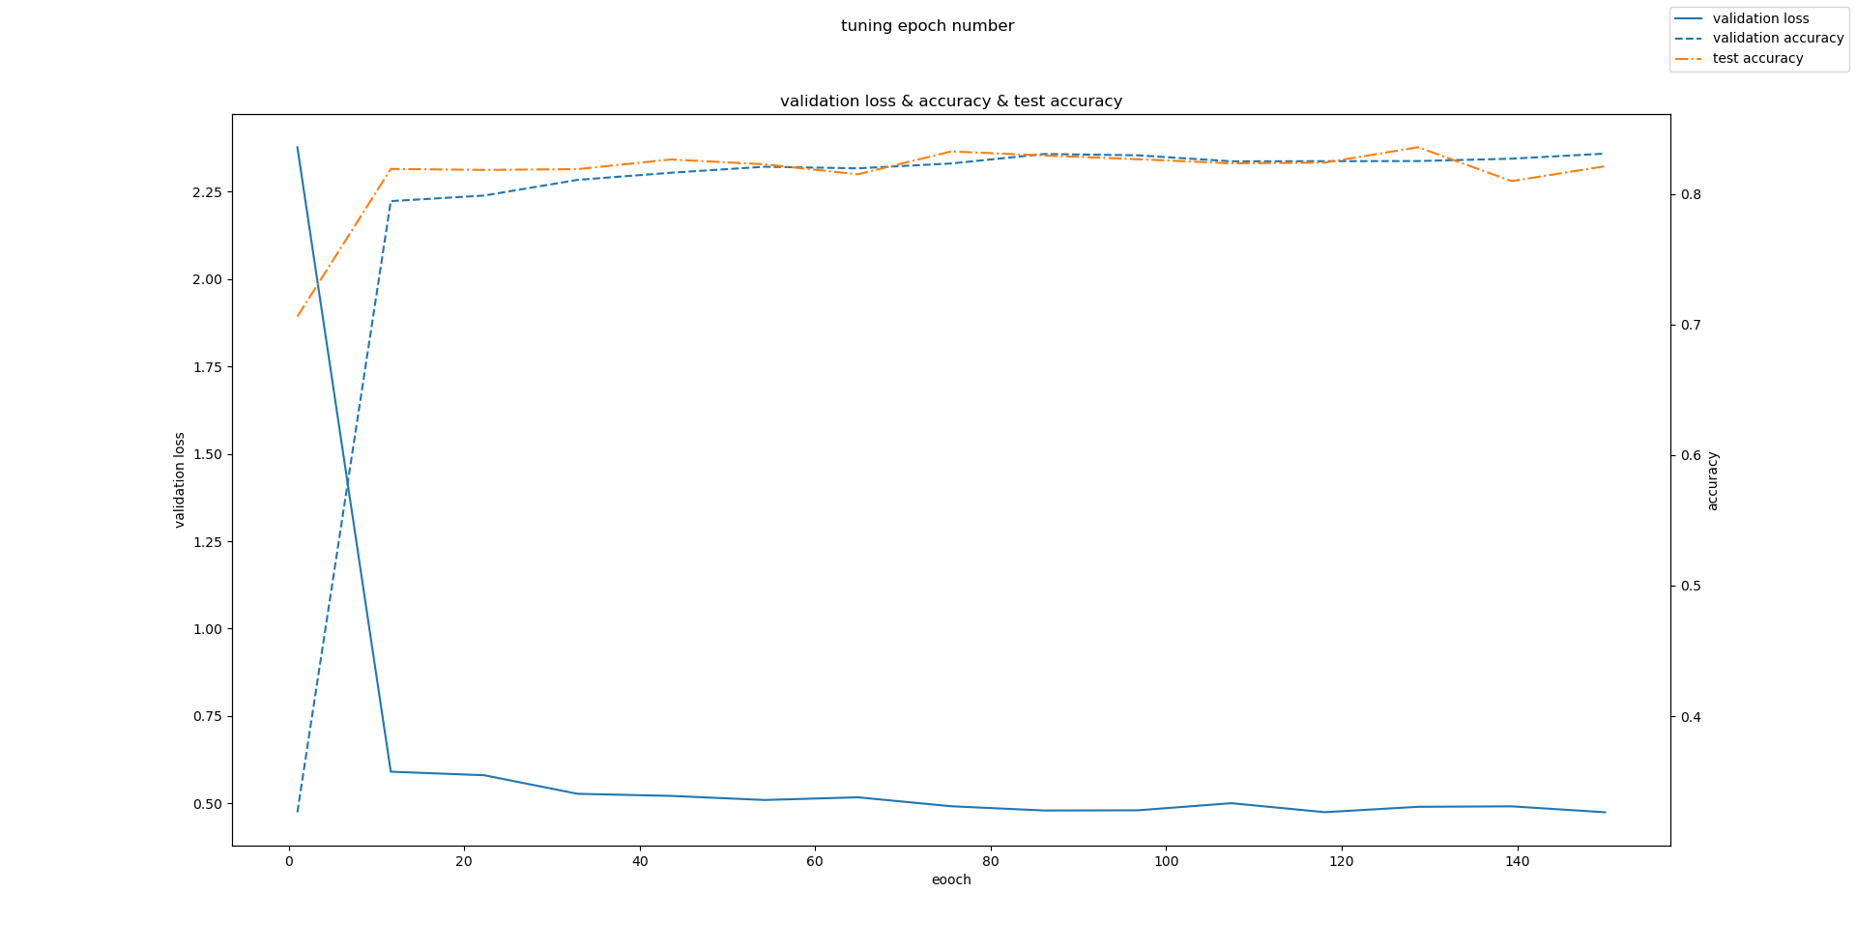
Epoch tuning
Notes:
Dropout makes validation accuracy lower

Slide 31
Optimizer Tuning
ADAM vs. SGD + Momentum:
How much weight decay (L2 regularization)?
Initial learning rate?
For SGD, momentum?

Slide 32
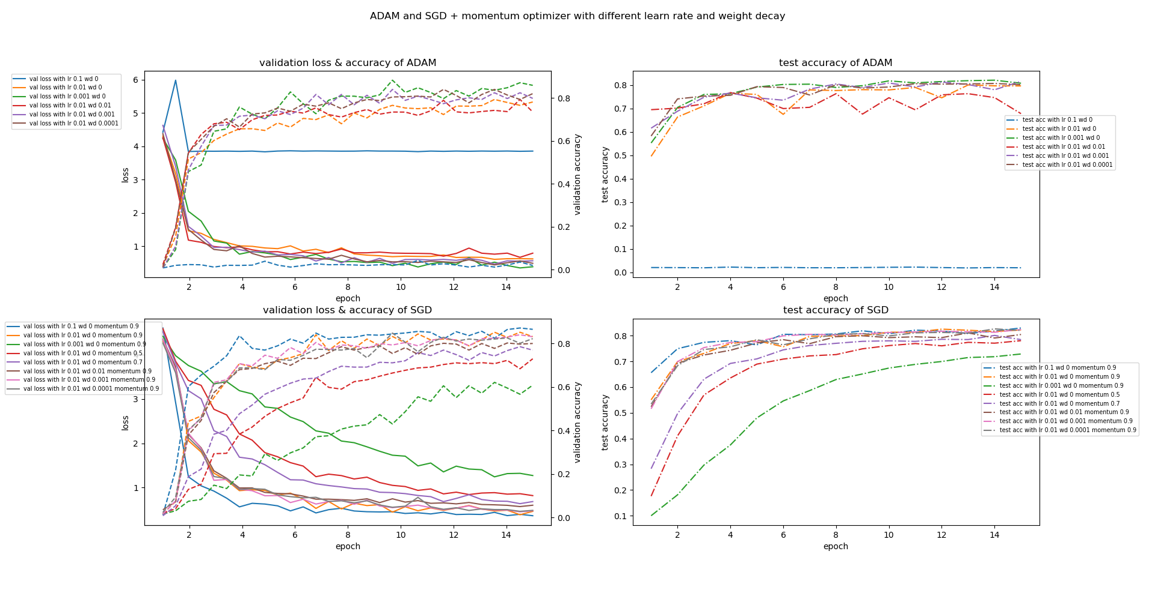

Slide 33
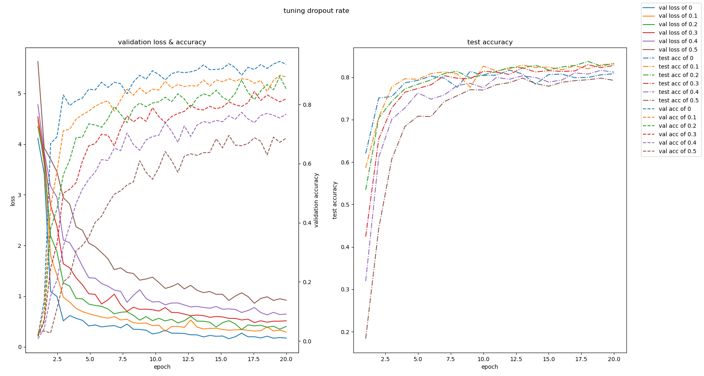
Dropout Rate Tuning

Slide 34
Training CNN
47x1 vector
FC 84, 47
ReLU
FC 120, 84
ReLU
FC 400, 120
A brief summary from the validation steps:
CNN with modified 2 Conv layers and 3 FC layers.
We take 20% to 25% of the dataset to train/validate/test the model
batch size of 256
Number of Epochs: 100
Optimizer: SGD+Momentum with no weight decay and 0.9 momentum
Dropout rate of
Use the parameters to train the model
Flatten
MaxPool 2x2 stride 2
BatchNorm & ReLU
16 Conv 5x5
MaxPool 2x2 stride 2
BatchNorm & ReLU
8 Conv 5x5
28x28 image
Architecture with 2 Conv layers and 3 FC layers

Slide 35
Training CNN
One problem: test accuracy capped at 87%. Better, but can we do better? (The answer is no we didn’t get any better lol)
Maybe because there are just too many classes
The trained CNN model achieves 99% accuracy with MNIST digits and 89% accuracy with English characters only
Potential solutions
Feature extraction + SVM
Apply a binary classifier before CNN.
Chose to implement the first one

Slide 36
CNN feature extraction + SVM
Extract features from 28x28 images, getting 84x1 vectors for SVM to classify.
Need to tune hyperparameters of SVM (C, gamma)
28x28
84x1
SVM
A

Slide 37
CNN feature extraction + SVM
Turned out that this approach yielded accuracy of approximately 75%, which is even worse than using CNN alone. Why? FC layers are brainless, but good!
47x1 vector
FC 84, 47
SVM
ReLU
FC 120, 84
ReLU
FC 400, 120

Slide 38
Prediction in Practice - Histogram Projection
Our approach involves no machine learning process.
Revisits some preprocessing techniques not used in preprocessing.
Count pixels horizontally for line segmentation and vertically for word/character segmentation.
Low peaks indicates potential segmentation column.
Set thresholds for segmentation.
Fast & easy once implemented, but needs a lot of manual tuning. A machine learning algorithm may be applied to learn segmentation thresholds for higher accuracy.

Slide 39
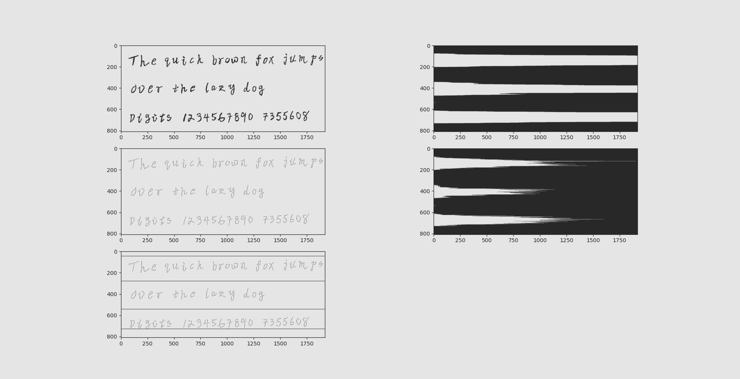
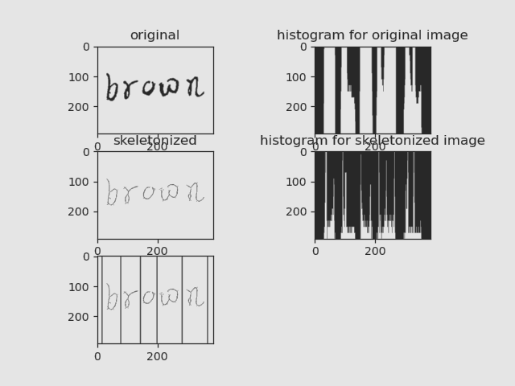
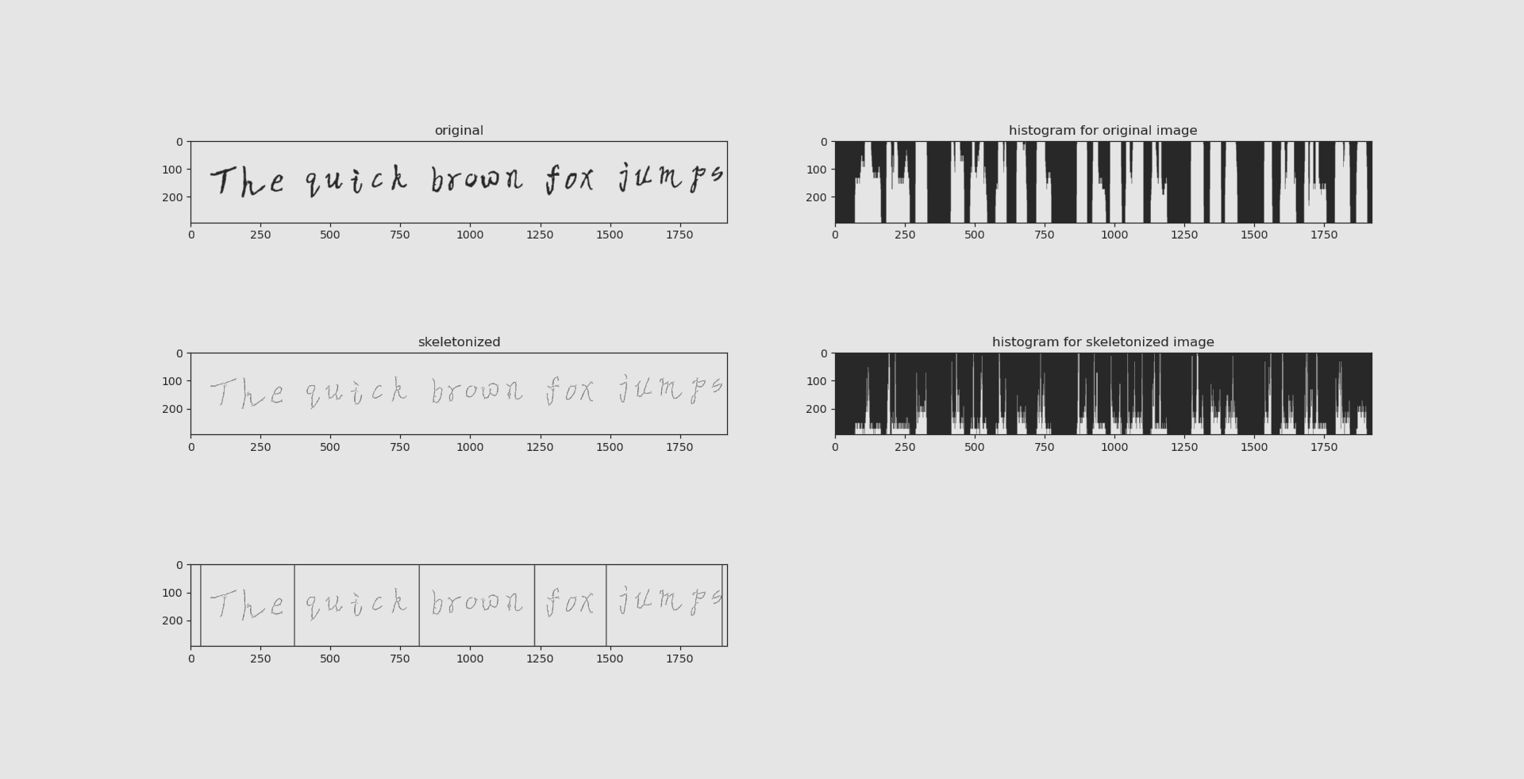
Prediction in Practice - Histogram Projection

Slide 40
Prediction in practice - Difficulties
Problems that have not been solved:
Input preprocess is not robust enough
Prediction demands very specific input resolution so that separate images won’t get poorly downsampled

Slide 41
CNN
CNN
CNN+SVM
Handwritten Recognition
SVM
Radial Basis Function
Decision Tree
Random Forest

Slide 42
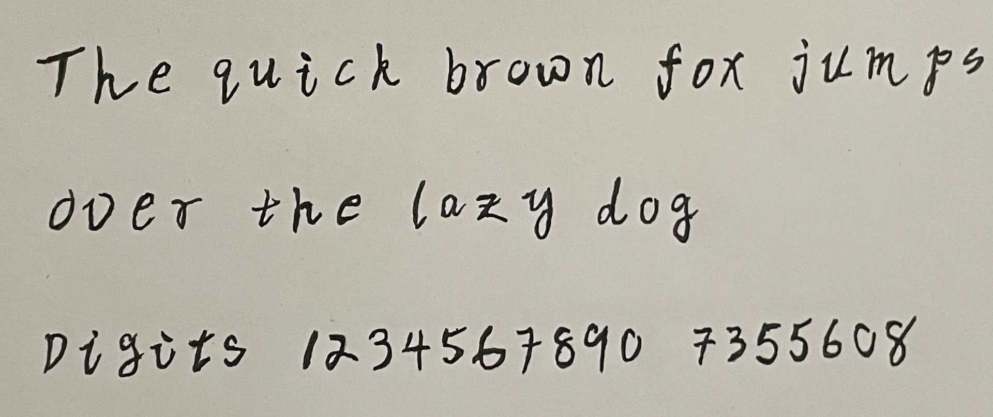
Prediction in Practice
In real life situation, OCR tends to perform on multiple characters, words, or even sentences, at once.
Segmentation is a big problem.
How can we segment the sentences so that we are dealing with one digit/character at a time?
Bad handwriting by Victor the presenter

Slide 43
Credits
Harold L. Erickson，Primary Editor https://www.britannica.com/topic/CNN
Cortes, C. & Vapnik, V., 1995. Support-vector networks. Machine learning, 20(3), pp.273–297.
Johannes Fürnkranz, Reference work entryDOI: https://doi.org/10.1007/978-0-387-30164-8_204

Slide 44
Thanks For Watching!

